Slide 1
Liver Disease Detection using ANN
Presented by:
SANJAY N
au513121104036
Thanthai Periyar Government Institute of Technology ,vellore - 632002

Slide 2
Agenda :
Problem Statement
Project Overview
End Users
Our Solution and Propositio
The Wow in Your Solution
Modeling
Results and Evaluation
Conclusion

Slide 3
Problem Statement :
Liver disease: A global health concern impacting millions, with early diagnosis being crucial for effective treatment and improved outcomes.
Traditional diagnosis: Relies on invasive procedures (biopsies, liver function tests) that are expensive, time-consuming, and uncomfortable for patients.
Need for improvement: There's a pressing need for a non-invasive, potentially faster approach to diagnose liver disease at an early stage.
This project aims to address this need by building a machine learning model capable of classifying liver disease based on patient data

Slide 4
Project Overview:
This project tackles the challenge of early liver disease detection.
Data Source: We'll use the Indian Liver Patient dataset, containing information on various liver function tests.
Model Training: We'll train a machine learning model to analyze this data and identify patterns associated with liver disease.
Early Detection Potential: This model can assist medical professionals in early diagnosis, leading to improved treatment plans and patient outcomes.

Slide 5
END USERS:
Patients
Healthcare Professionals
Medical Researchers
Healthcare Institutions
Public Health Authorities
Pharmaceutical Companies

Slide 6
the SOLUTION AND ITS VALUE PROPOSITION:
Solution:
The solution leverages a neural network model built using Keras.
The model analyzes various patient health features like total proteins, albumin levels, and gender to predict the presence or absence of liver disease.
Data preprocessing techniques like encoding categorical variables and handling missing values are employed to prepare the data for model training.
The model is trained and evaluated on a split of the dataset, ensuring its generalizability to unseen data.

Slide 7
Value Proposition:
Early Disease Detection: The model can potentially aid in the early detection of liver disease, allowing for timely intervention and improved patient outcomes. Early detection is crucial for managing liver diseases effectively and preventing complications.
Improved Diagnostic Efficiency: The model could be used as a decision-support tool for doctors, assisting in diagnosis and potentially reducing reliance on expensive or invasive procedures.
Personalized Medicine: In the future, such models could be integrated with other patient data to personalize treatment plans for liver diseases.

Slide 8
THE “WOW” IN SOLUTION
High Accuracy
Early Stage Prediction
Explainability
Transparency
Generalizability
Personalization

Slide 9
MODELING
Data Loading and Preprocessing:
Load the dataset containing information about liver patients.
Perform data preprocessing steps such as transforming the target variable into binary form, encoding categorical variables, and handling missing values.
Exploratory Data Analysis (EDA):
Explore the dataset using visualizations like count plots and box plots to understand the distribution of liver disease cases and the relationship between various features and the target variable.
Model Development:
Construct a Sequential model using Keras, which is a high-level neural networks API.
Add layers to the model, including Dense layers for fully connected layers and Dropout layers for regularization to prevent overfitting.
Compile the model with appropriate optimizer, loss function, and metrics.

Slide 10
Model Training:
Split the dataset into training and testing sets using from scikit-learn.
Standardize the input features using StandardScaler to ensure uniformity and improve convergence during training.
Train the model on the training data using fit method, specifying the batch size and number of epochs.
Model Evaluation:
Make predictions on the test dataset using the trained model.
Convert the predicted probabilities to binary predictions using a threshold of 0.5.
Evaluate the model's performance using metrics such as confusion matrix, classification report, and accuracy score.

Slide 11
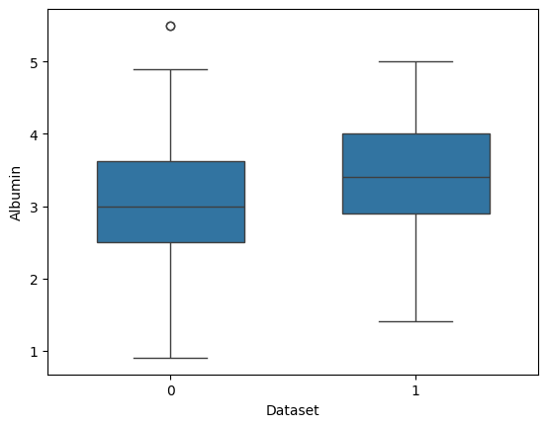
Model EVALUATION by visualisation

Slide 12
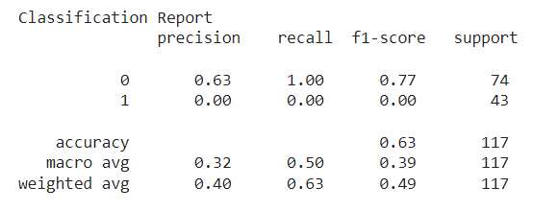
EVALUATION

Slide 13
CONCLUSION:
This project explored the potential of machine learning for classifying liver disease using a patient health dataset
While this initial approach provides a foundation, future advancements can significantly enhance the solution's value.
Techniques for interpretable machine learning would allow doctors to understand the model's reasoning and build trust in its predictions.
Overall, this project demonstrates the promise of machine learning in aiding liver disease diagnosis.

Slide 14
THANK YOU

